Slide 1
Social Impact Marketing Project Presentation
One Earth One Chance
Team 4
Ajit Benedict, Laiba Shaikh, Karlee Scott,
Kirthi Arimanda, Isha Patel

Slide 2
About One Earth One Chance
Core Values: Integrity, compassion, collaboration, and excellence guide all OEOC initiatives.
Mission:
Human adaptation to the environment; integration of science, social studies, and humanities.
Promote climate resilience,
Provide actionable solutions through projects like urban reforestation, community engagement, and educational programs
Key Focus Areas:
Tree Planting: Combat urban heat islands, absorb carbon dioxide, and improve air and water quality.
Litter Cleanup: Organize community events to prevent waste from polluting rivers, oceans, and landfills.
Net Zero Initiatives: Advocate for reducing single-use plastics, promoting sustainable consumption, and showcasing eco-friendly practices like composting and recycling.
Approach:Empower individuals to "think globally, act locally."
Achievements: Over 3000 trees and shrubs planted, with measurable environmental benefits​
Business Problem: “One Earth One Chance (OEOC) aims to address the pressing issue of environmental degradation and the challenges posed by human adaptation to climate change. The organization faces the need to create widespread awareness and provide practical, scalable solutions to foster environmental stewardship, promote sustainability, and mitigate climate change impacts through reforestation, community engagement, and educational initiatives. They are accomplishing this through small tangible and impactful action that drive to mitigate climate change along with promote environmentally conscious world through sustainability initiatives and community involvement.

Slide 3
Project Deliverables
Write 12 strategic blogs to develop educational content to raise awareness and drive community interaction
Aim to improve understanding of environmental issues and sustainable practices with an emphasis on solving the problems of human adaptation to the environment

Slide 4

Objective
Foster a community of learners and educators by driving interaction, participation, and engagement around the diverse blog content.
Position organization as trusted information source for environmental stewardship
Boost website traffic and improve visibility.The website traffic can be quantitative measurement. Blogs can be content for social media
Create engaging platform that broadens reach and resonates with environmental enthusiasts audience
Raise awareness, educate, and build an engaged community

Slide 5
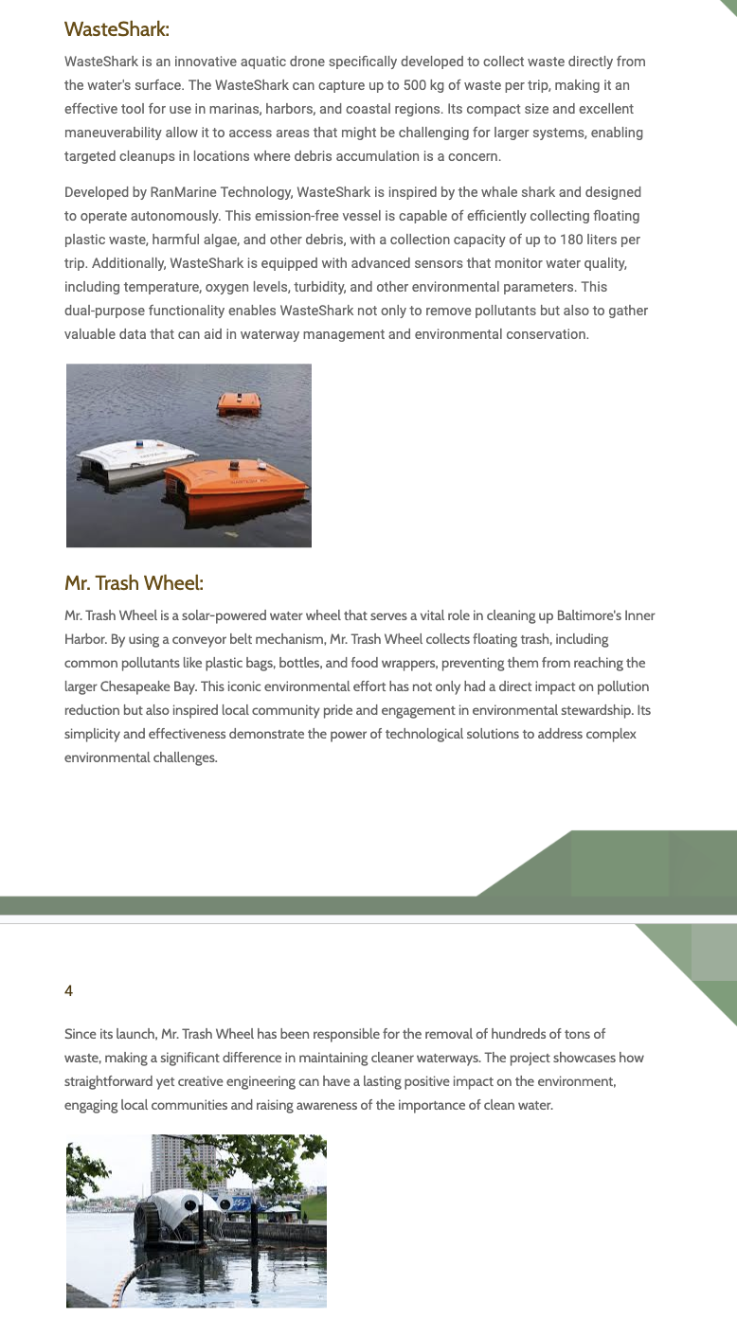
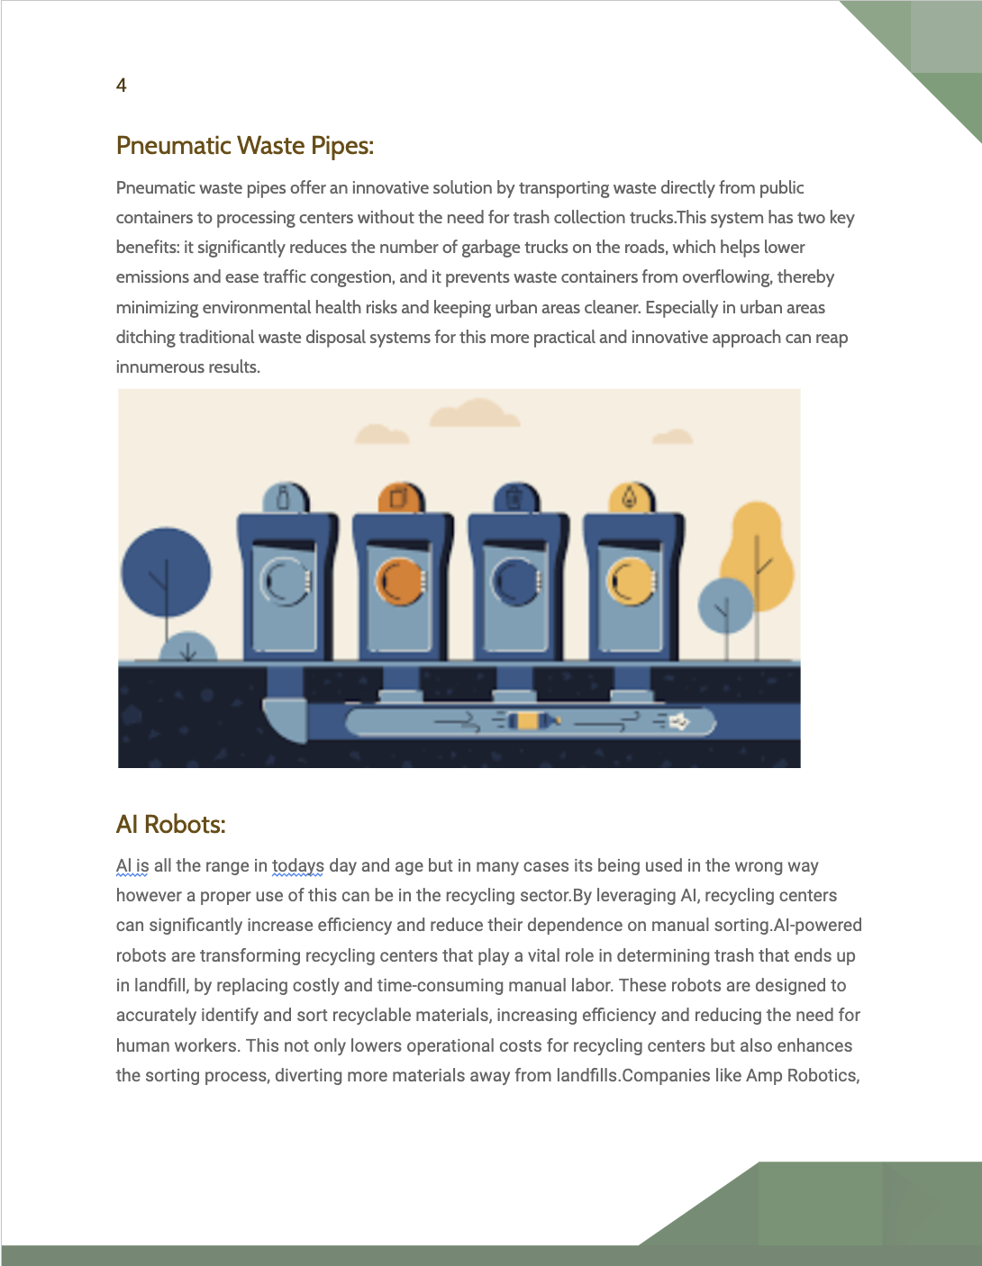
Blogs Delivered
Focus Areas: Technological innovation, regulations, and success stories in Restoration and Wildlife, Waste and Recycling, Water and Oceans
Improve existing curriculum through high-quality, compelling, and digestible pieces and integration of blogs as educational resource
Highlight new technology/ innovations to inspire action in an engaging way.
Showcase real-world examples of success to show the tangible impact of positive actions and motivate to contribute
Technology Innovations in Waste Management and Recycling
Technology Innovations in Water and Ocean

Slide 6
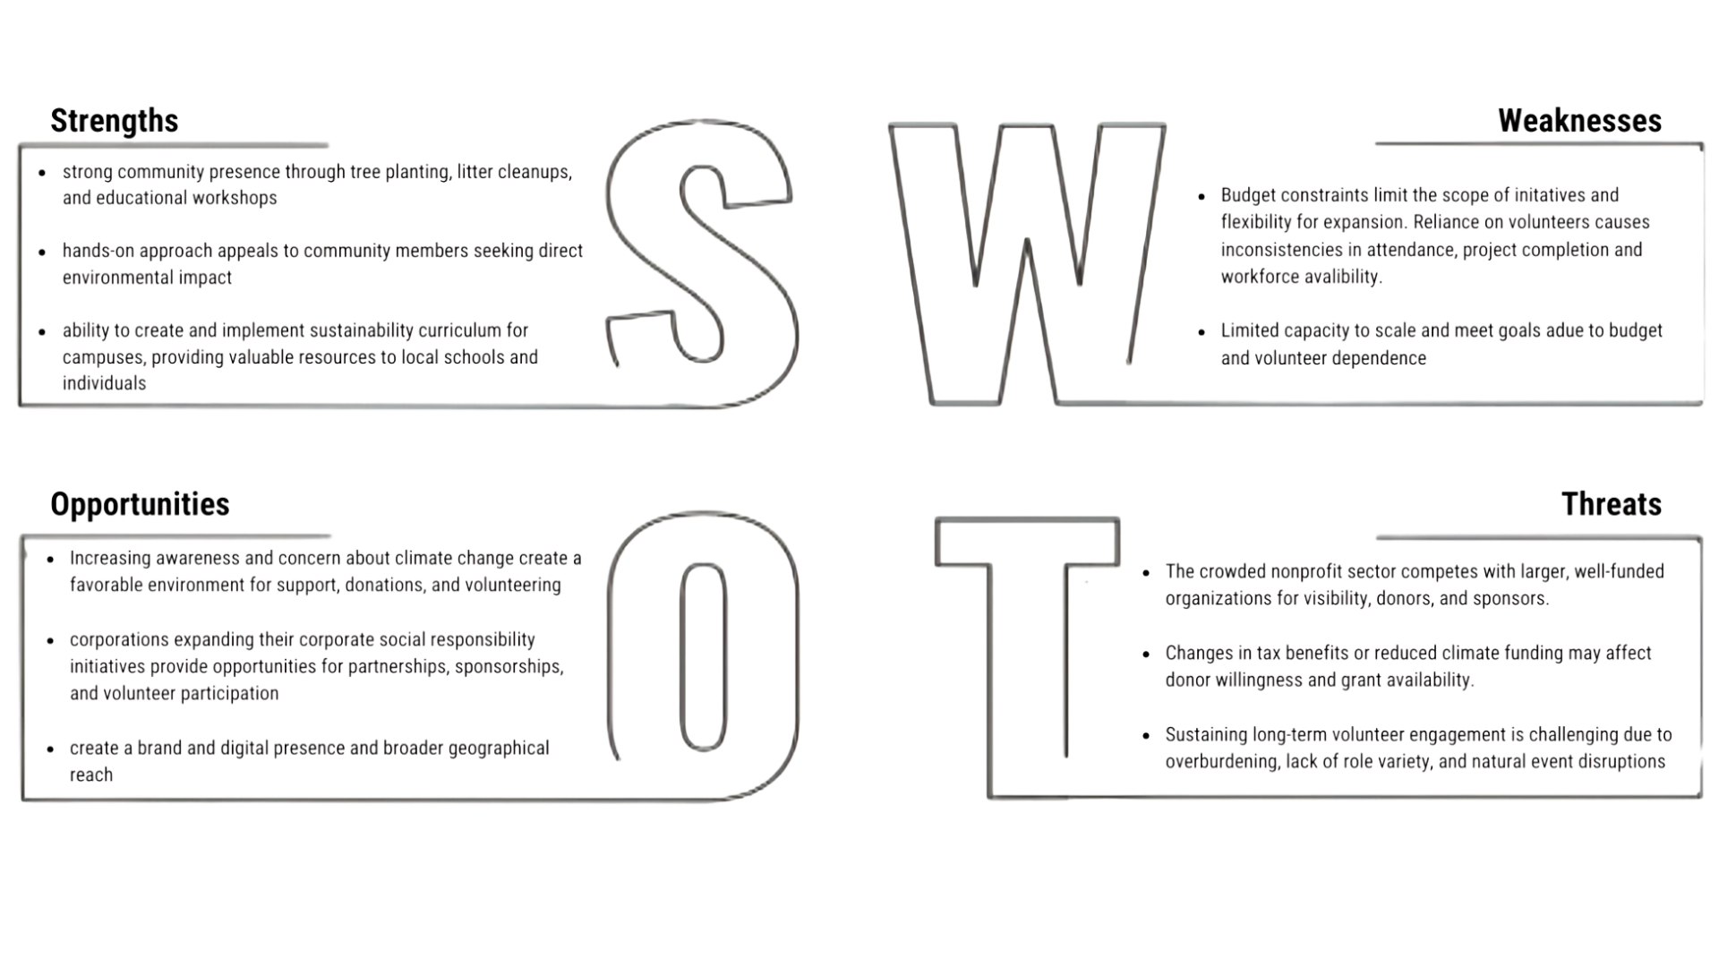
Situational Analysis

Slide 7

Value Proposition
No competition = Nonprofit focused on greater good ➡️Unique = holistic approach, integrating education, collective action, and community building
Empower for meaningful action against climate change
Provide resources, opportunities to participate in sustainable practices , educational programs, impactful outreach, handson projects, and community engagement event
Grassroot action + Stewardship = Foster immediate & long term climate resilience
Tree planting ➡️ urban beautification ➡️ Tangible & visible outcome ➡️ healthier planet for future generations

Slide 8

Positioning
Primary Target Audience: Environmentally conscious high school students who prioritize sustainability and motivated to take action
Secondary Target Audience: Socially active individuals interested in educating themselves and making an impact.
Collaborations with:
Educational institutions
Local governments
Volunteers
UTD students who contribute expertise in content development and branding
Funding
Key Donors: Donate $500+ annually. Invited to appreciation events and receive additional recognition.
Member Donors: Donate $100+ annually.
Corporations
Grants

Slide 9

💡 Revenue-Generating Initiatives
📲 Social Media Monetization: Leverage social media as revenue stream and tool to boost popularity.
🌳 Adopt-a-Tree Program: Donors can contribute a set amount to adopt a tree. Donors would receive a digital certificate, updates on tree's growth, and tree's coordinates, creating personal connection
🎟️ Membership Program: Offer an intriguing and attractive membership option where, after an upfront payment, supporters can gain exclusive benefits like mixers, events, and insider access.
🏢 Corporate Partnerships: Brand recognition, CSR (Corporate Social Responsibility) benefits, Enhance reach through corporate networks.
🤝 Crowdfunding Campaigns: GoFundMe initiatives, more visibility beyond existing supporters to potential new donors
🛍️ Eco-Friendly Merchandise: Develop eco-friendly merchandise (e.g., reusable water bottles, tote bags, shirts, seed packets) to sell at events, online, or through local stores. These products could also be given as gifts to volunteers, offering both brand visibility and revenue generation. OEOC could partner with companies that already offer eco-friendly products, earning a commission on purchases made

Slide 10

Future Recommendations
🎮Leverage cutting-edge initiatives, like virtual reality experiences and gamified challenges
🌿Strategic eco-friendly social media challenges
🤝 Host sustainability workshops or community-based sustainability events
Celebrate a memorable Earth Day (April 22, 2025)
📈 Increase website traffic through targeted advertising campaigns with environmental influencers to attract right demographic

Slide 11
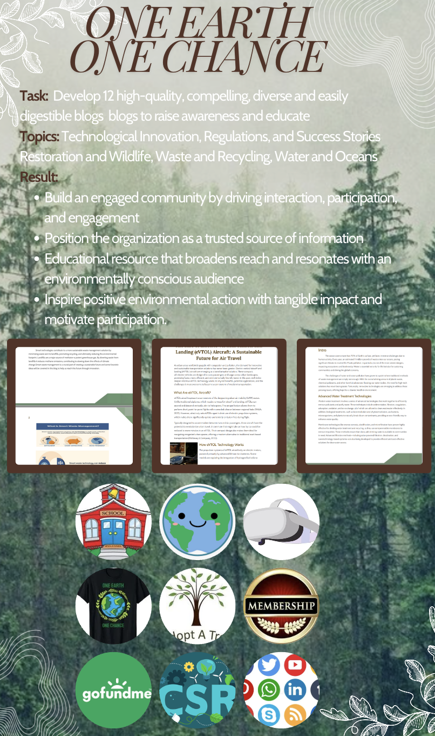
Thank You!!

