Slide 1
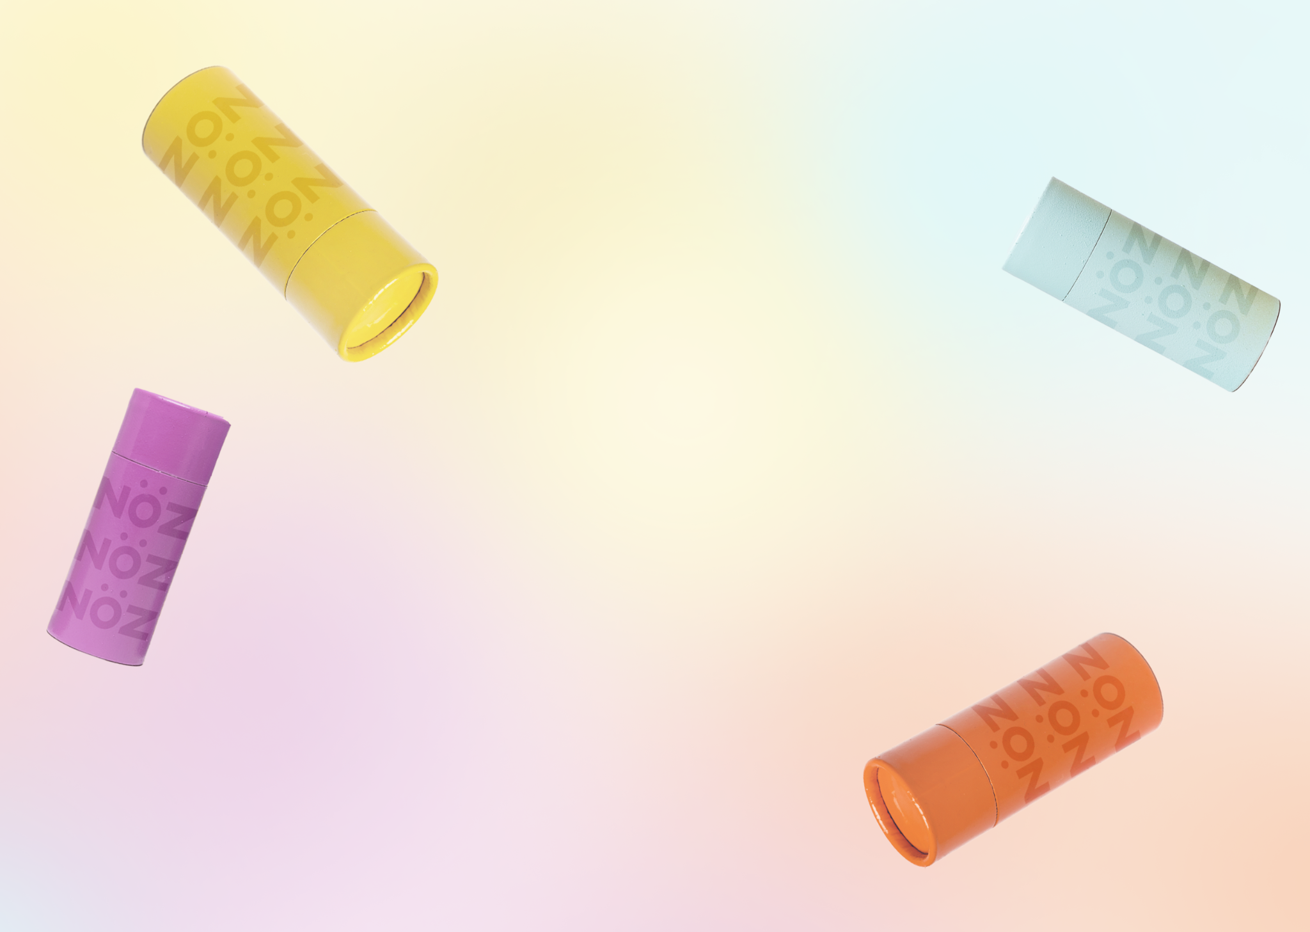
Portfolio Project
ishapatel.myshopify.com
Isha Patel
10/04/2025

Slide 2
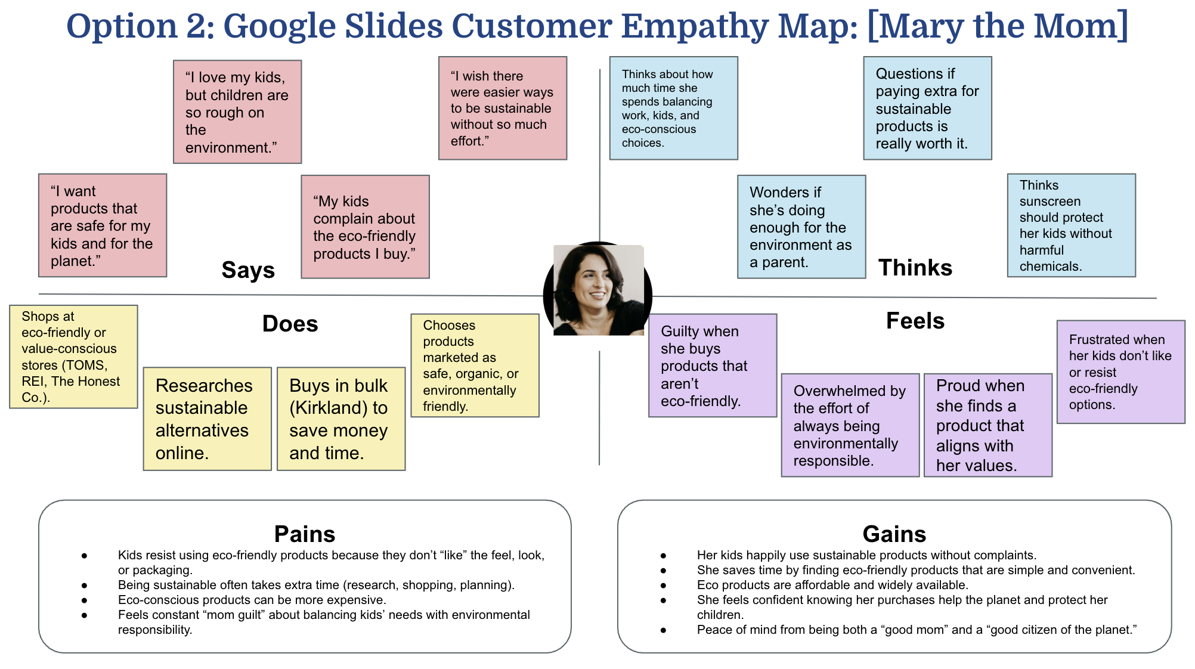
Target Customer
Mary the Mom
Nöz offers safe, dermatologist-approved sun care that protects their skin and the planet while fitting seamlessly into their daily routine. It provides peace of mind with effective, eco-friendly protection that the whole family can rely on.

Slide 3
Value Proposition
We sell reef-safe, vegan, cruelty-free sunscreen designed for families who care about safety and sustainability. For eco-conscious moms like Mary, Noz makes sun protection fun and worry-free with bold neon colors kids love and formulas that are gentle on skin and the planet.

Slide 4
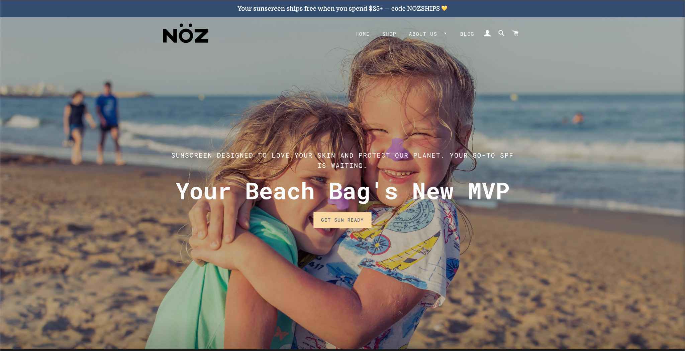
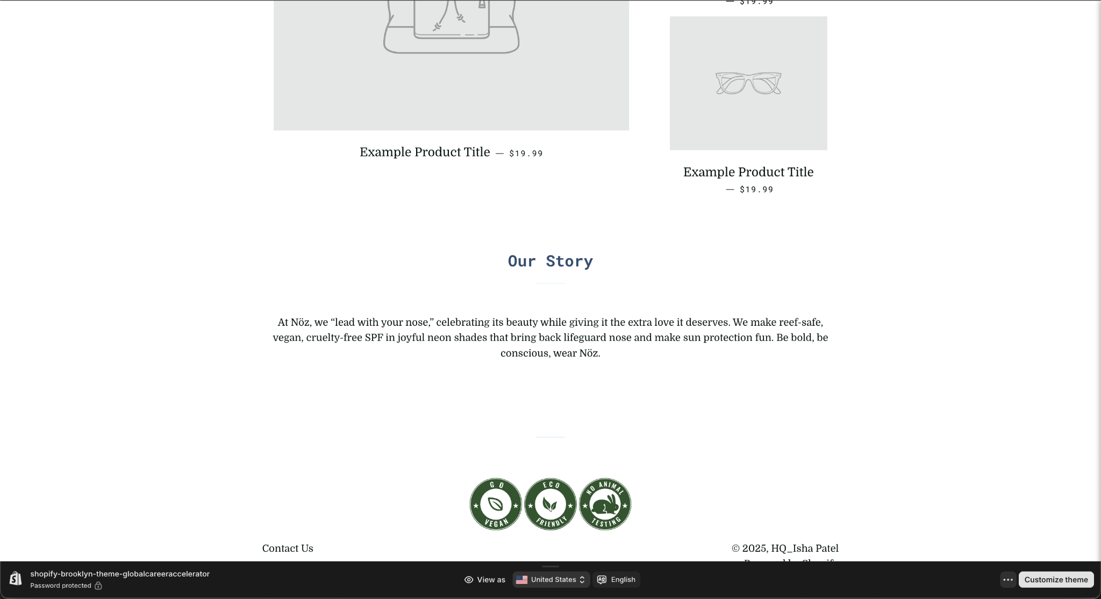
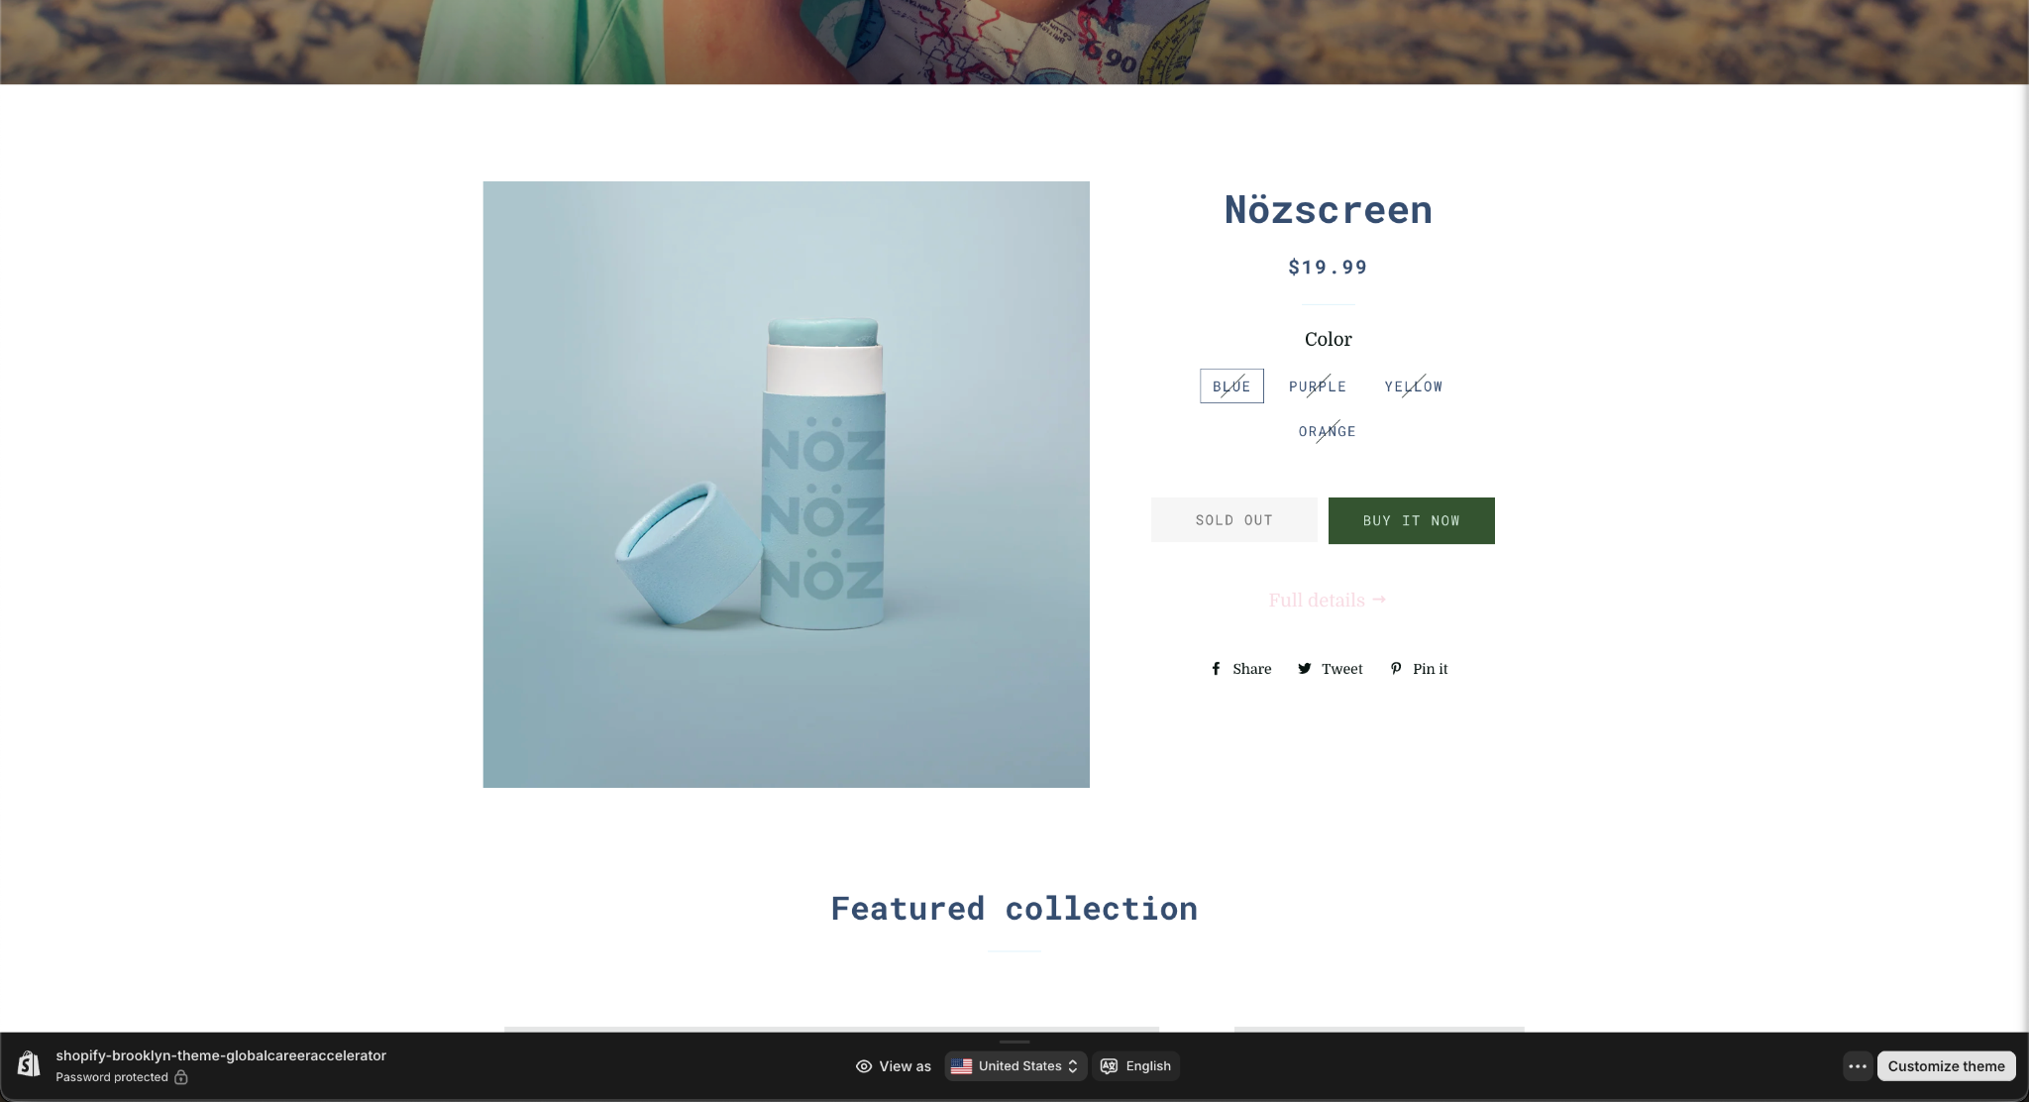
Value Proposition
I made sure the value proposition was featured across multiple sections of my site, including the homepage, product page, and About Us page, because it is central to how Nöz connects with customers. On the homepage, it is introduced through bold, playful messaging that immediately shows visitors what the brand stands for: safe, sustainable sun protection that is fun for the whole family. On the product page, it is reinforced with details about the product itself, highlighting that Nöz is reef-safe, vegan, cruelty-free, and dermatologist-approved, while also being colorful and kid-friendly. On the About Us page, the value proposition is expanded into the story behind the brand, showing our deeper purpose and commitment to safety, sustainability, and making sun care something families actually look forward to using.
Placing it in all three sections ensures visitors encounter Nöz’s core message, which is protection that is gentle on skin and the planet, with bright colors kids love and formulas families can trust, no matter where they are in their journey through the site. This consistent messaging builds credibility, strengthens brand identity, and ultimately makes it easier to convert visitors into customers.

Slide 5
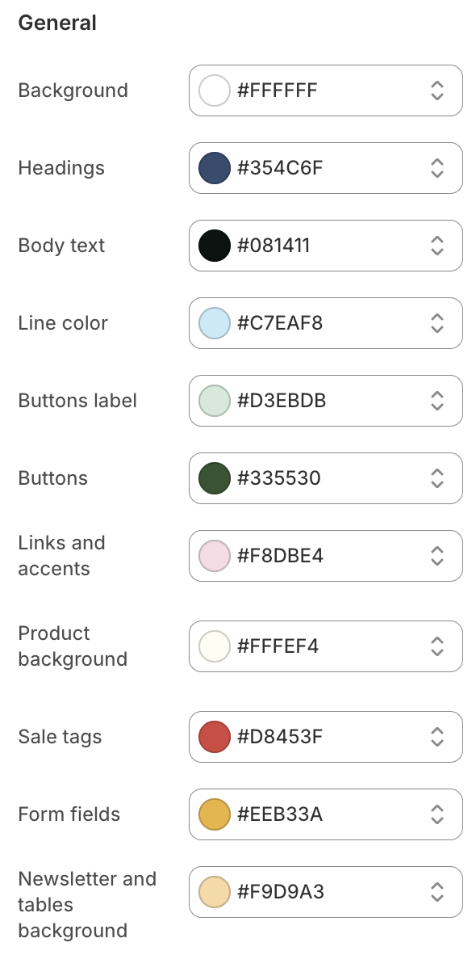
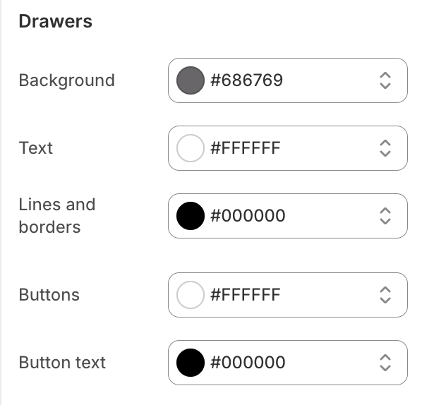
Brand Visuals - Color Palette
Our color palette was chosen to communicate a sense of cleanliness, trust, and sustainability while still feeling playful and approachable, which are core parts of Nöz’s brand identity. The base of soft whites and creams creates a clean, minimal foundation that reflects the purity and simplicity of our reef-safe, vegan formulas. Shades of blue and green are used throughout to evoke feelings of calm, safety, and environmental consciousness, reinforcing our commitment to protecting both skin and the planet.
To keep the site fun and engaging, especially for younger audiences and families, we incorporated subtle pops of pastel pink, yellow, and red. These accent colors add a playful, energetic feel without overwhelming the design and mirror the bright, colorful personality of our products. Finally, the use of contrasting neutrals like charcoal and black ensures that key elements such as buttons and text remain easy to read and visually impactful, guiding users naturally toward calls to action.

Slide 6
Brand Visuals - Photography
We chose this hero image because it perfectly captures the heart of Nöz’s brand: playful, vibrant, and family-friendly sun protection that’s as fun as it is effective. The image of two smiling children on the beach immediately communicates joy, warmth, and carefree summer moments, which aligns with our mission to make sun safety something families actually look forward to.
The bright natural lighting and pops of color in the sunscreen on their noses reinforce our brand’s emphasis on bold, cheerful aesthetics while highlighting the product’s unique design and purpose. It also visually reflects key brand pillars like eco-consciousness and family-centric values by showing the product being used outdoors in a natural environment. Most importantly, the photo feels approachable and real, which helps build trust with our target audience of parents looking for safe, sustainable, and fun SPF solutions for their families.

Slide 7
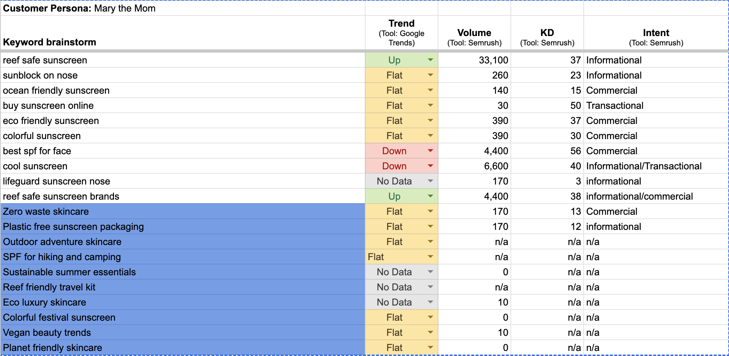
SEO - Keyword research
Reef safe sunscreen
Eco friendly sunscreen
Zero waste skincare
Colorful sunscreen
Vegan beauty
I chose these keywords because they are highly relevant to Nöz’s brand values and product benefits, reflecting what your target audience is actively searching for. They also balance high search volume terms (“reef safe sunscreen” and “eco friendly sunscreen”) with more niche but differentiating phrases (“zero waste skincare,” “colorful sunscreen,” and “vegan beauty”), which helps improve SEO while showcasing Nöz’s unique positioning.

Slide 8
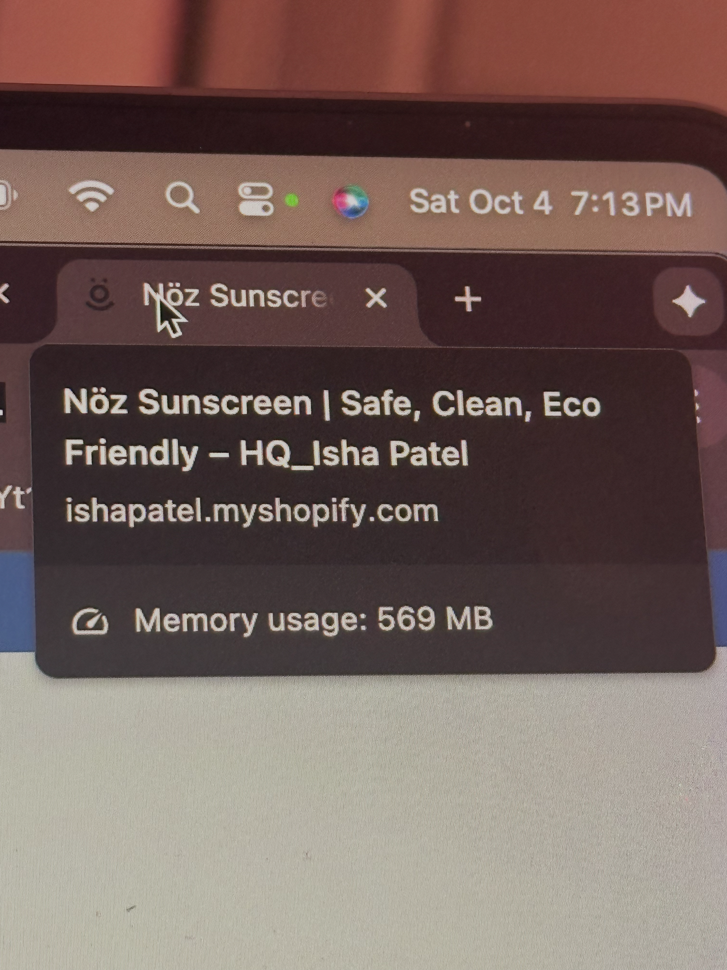
SEO - Site Meta Tags
A site’s meta title is crucial for SEO because it helps search engines understand what your page is about and directly influences how your site appears in search results, improving visibility and click-through rates.
  Clean
  Safe
  Eco friendly sunscreen

Slide 9

Landing Page Optimization
Color contrast
Clear CTA buttons
Strategic whitespace
Directional cues in imagery
Trust badges and secure checkout icons
Simplified navigation
Optimized hero section with offer messaging
Consistent brand color palette
High-quality, relevant imagery
Social proof through reviews

Slide 10
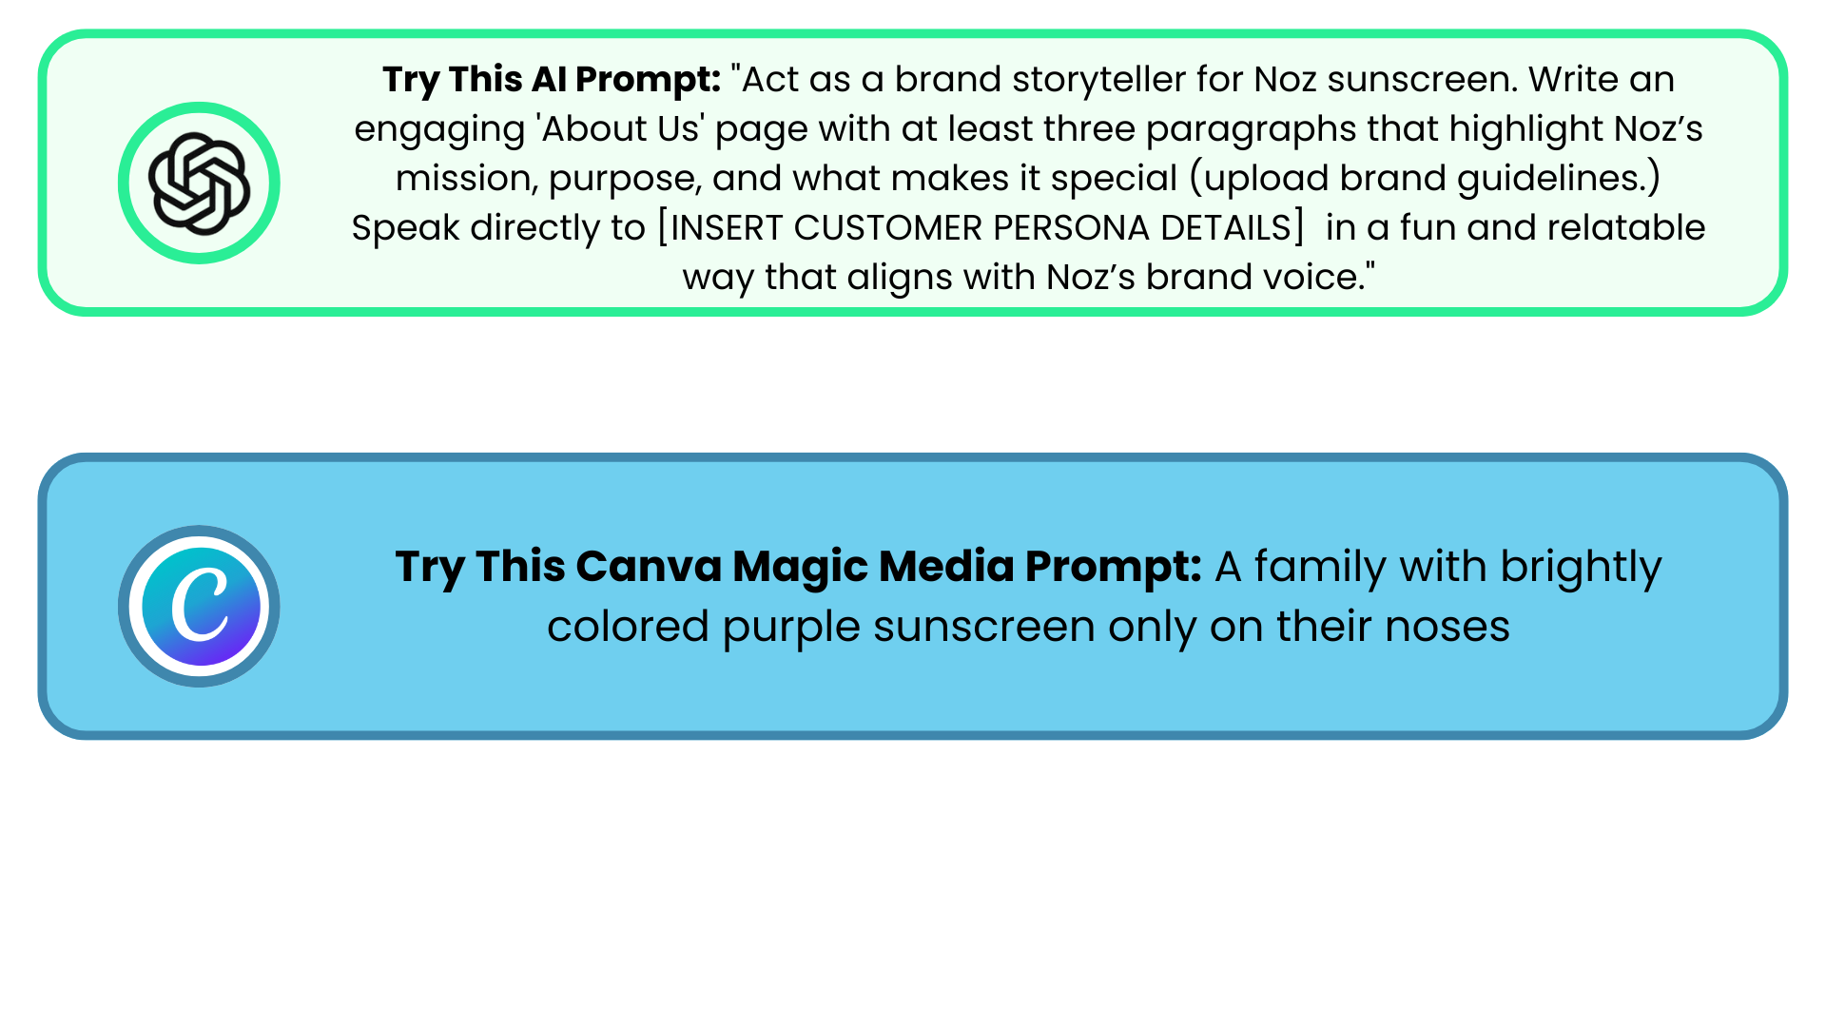
Build Out Your New About Page
Create “About Us” page content using brand guidelines and ChatGPT!
  Create at least 3 paragraphs of copy that talks directly to target audience (your persona) about the purpose/mission of Noz and add a screenshot of your programmed copy on the next slide
  Create 3 images using ChatGPT and or Canva and add a screenshot of your programmed images on the next slide
Example Prompt for About Page Copy:
Example Prompt for About Page Images:

Slide 11
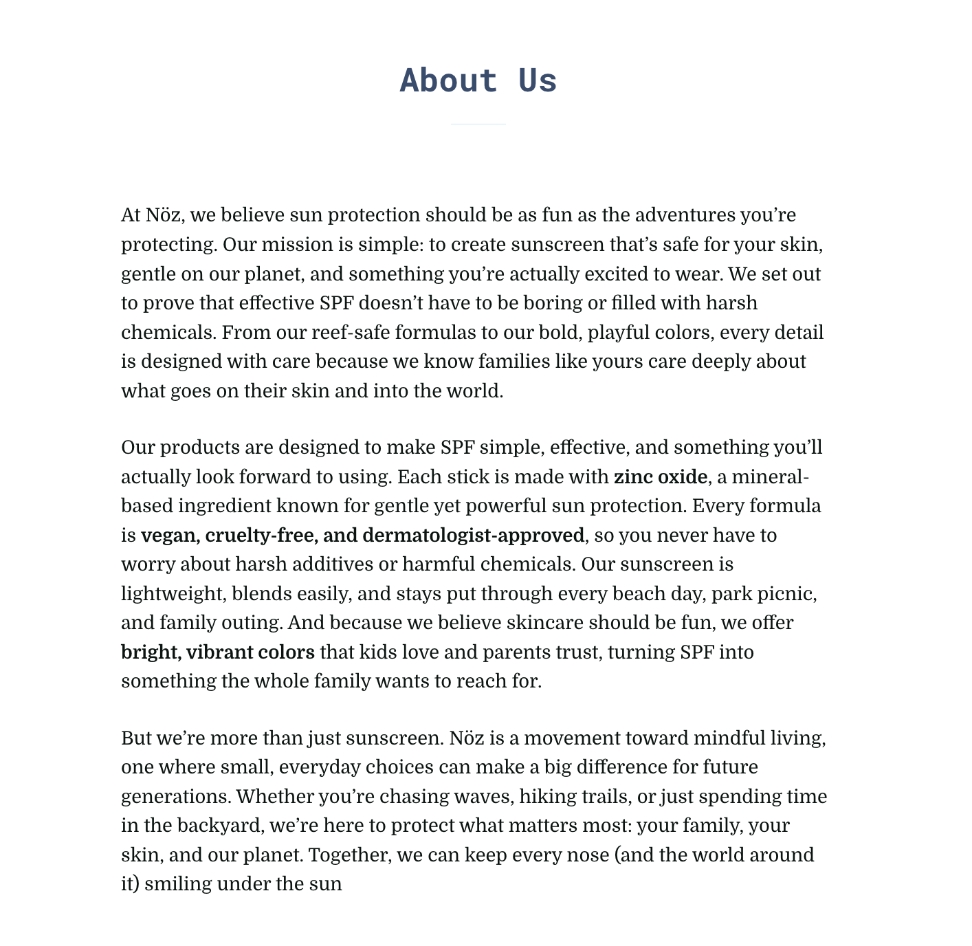
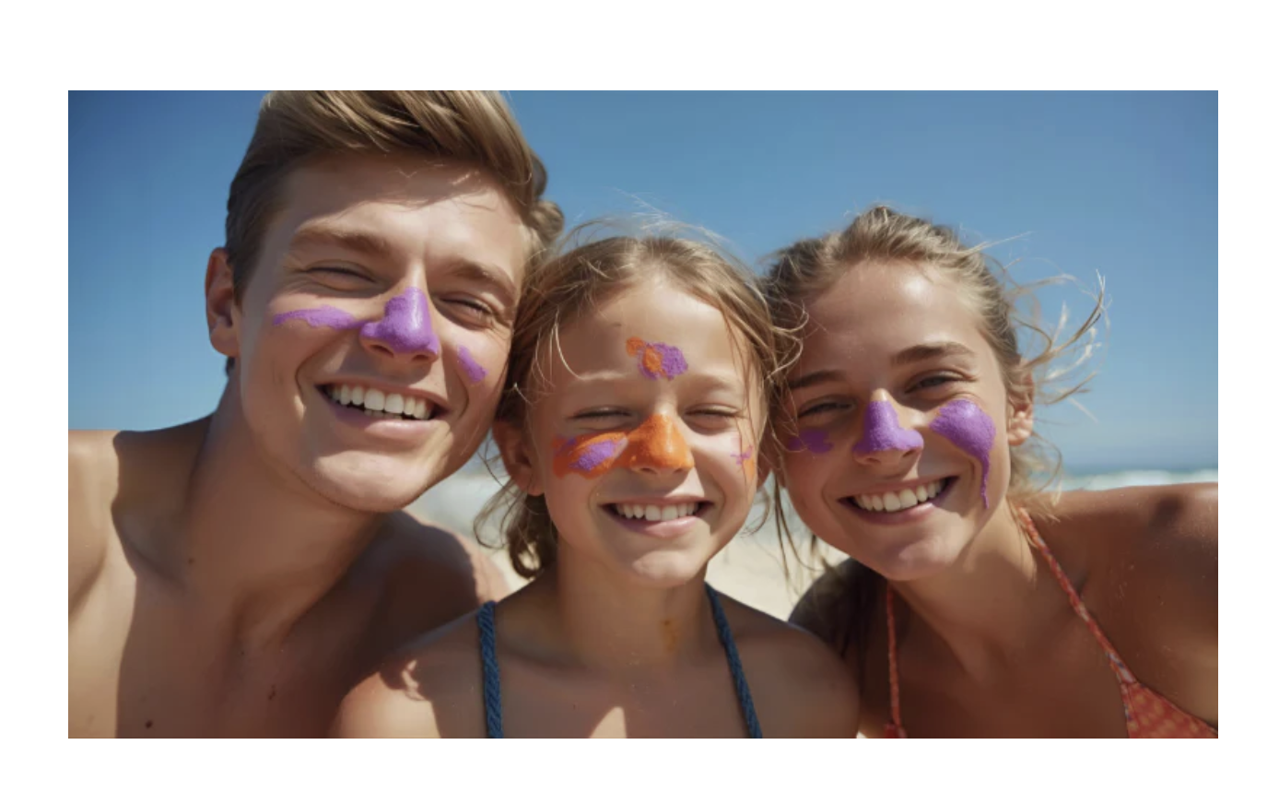
Build Out Your New About Page

Slide 12
Executive Summary
Purpose: The Nöz website project was designed to create a playful, eco-conscious, and conversion-focused eCommerce experience for a modern skincare audience. My goal was to position Nöz as a trusted, sustainable sunscreen brand that balances safety, style, and fun while driving engagement, building brand loyalty, and increasing conversions.
Key Learnings:
Target Customer Persona:
  I designed the website with eco-conscious, safety-focused shoppers like Mary the Mom in mind. These are individuals who prioritize clean ingredients, sustainability, and skin-safe products that are fun and effective. Every element of the site was tailored to appeal to this audience while still being welcoming to a broader demographic.
Value Proposition:
  Nöz offers reef-safe, vegan, cruelty-free sunscreen with bold, kid-friendly colors and gentle, dermatologist-recommended formulas. The value proposition highlights our commitment to sustainability, family-friendly protection, and eco-conscious choices, setting Nöz apart from traditional sun care brands.
Brand Messaging & Visual Identity:
  I ensured that the brand’s playful yet trustworthy voice and vibrant visual identity were consistently represented across the site. From homepage headlines to product descriptions, every piece of messaging reinforced Nöz’s purpose of protecting skin and the planet in a way that is fun, safe, and sustainable.
Key Marketing Assets:
  I developed essential marketing materials including homepage hero copy, an engaging About Us story, SEO-optimized meta titles, email campaigns, and an abandoned cart series. These assets worked together to drive visibility, encourage conversions, and strengthen the brand’s identity.
Landing Page Optimization & A/B Testing:
  I implemented CRO strategies such as color contrast, whitespace, CTA optimization, trust badges, and A/B testing to improve user experience and increase conversion rates. Testing variations of key elements like calls to action and messaging helped identify what resonated most with our audience.

Slide 13
Executive Summary Example
Purpose: The Quip website launch project was designed to create a user-centric, visually compelling, and highly optimized eCommerce experience for Quip. My goal was to position the brand for long-term growth, attract new customers, and increase conversion rates.
Key Learnings:
Target Customer Persona:
I designed the website with the modern, health-conscious consumer in mind—individuals who value oral care, convenience, and quality design. The design and messaging catered to a demographic seeking effective, stylish, and sustainable toothbrushes and oral care products.
Value Proposition:
Quip offers high-quality, simple, and effective oral care solutions with a commitment to design, sustainability, and ease of use. I made sure the site communicated these values through its design, messaging, and product offerings, positioning Quip as a trusted, go-to brand for everyday oral hygiene.
Brand Messaging & Visual Identity:
I ensured that the brand’s voice and visual identity were consistently represented throughout the site. From the homepage to the product pages, Quip’s tone remained sleek, friendly, and inviting, reinforcing the message of smart, simple, and effective oral care.
Key Marketing Assets:
I strategically used SEO through keyword optimization, engaging copy, high-quality imagery, customer reviews, trust badges, and compelling email campaigns. These assets were designed to drive traffic, enhance credibility, and convert visitors into loyal customers.
Landing Page Optimization & A/B Testing:
I focused on optimizing key landing pages using A/B testing strategies. I tested different versions of the homepage and product pages to evaluate which designs, copy, and calls to action performed best.

Slide 14
Screen Record Your Noz Store
To preserve all the hard work you put into your Noz store, you’ll want to document it. Screen record your store and copy and paste the link to your recording onto this slide.
But first, before you screen record, be sure to watch this video that gives you step-by-step instructions on how to record and explain the work you did.
Be sure to utilize your Executive Summary from slide 13 as your script.
https://www.loom.com/share/c6af1a2f80294e8494b03bb6b31de9a9?sid=e394d968-740a-4880-ad24-d9f2bacb26ff

Slide 15
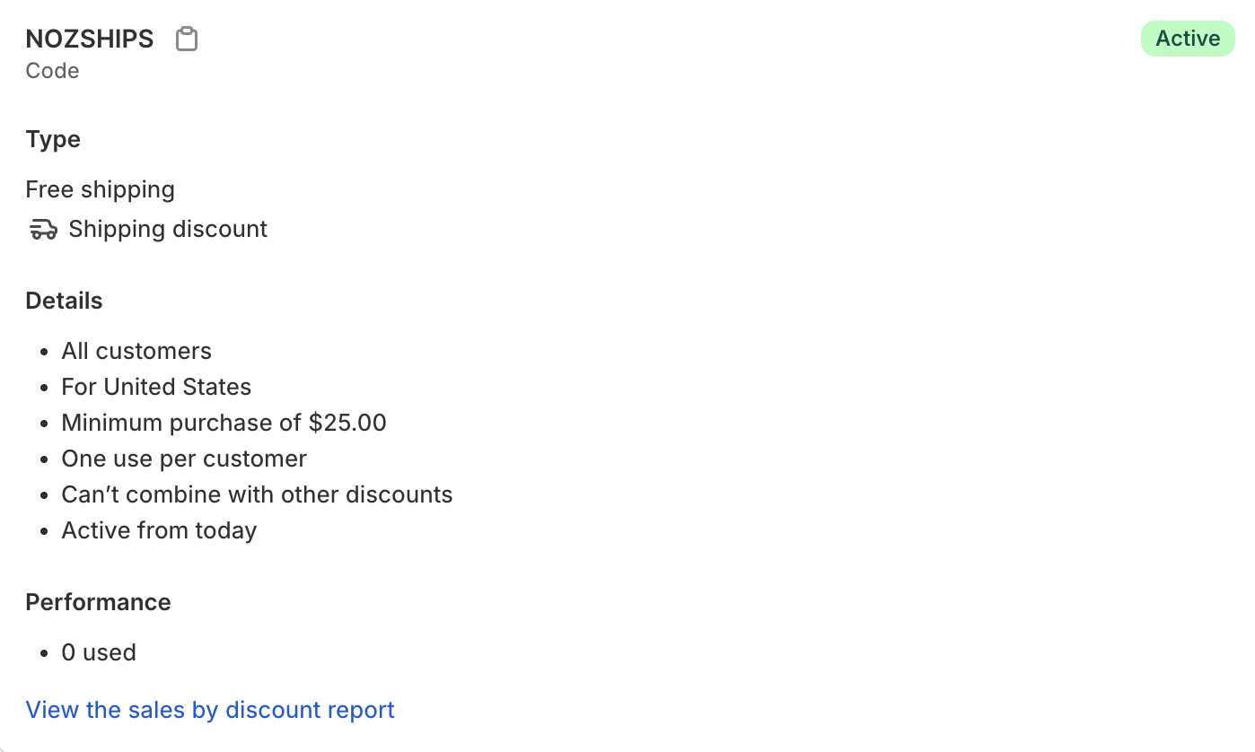

Promos & Offers (Level Up)

Slide 16
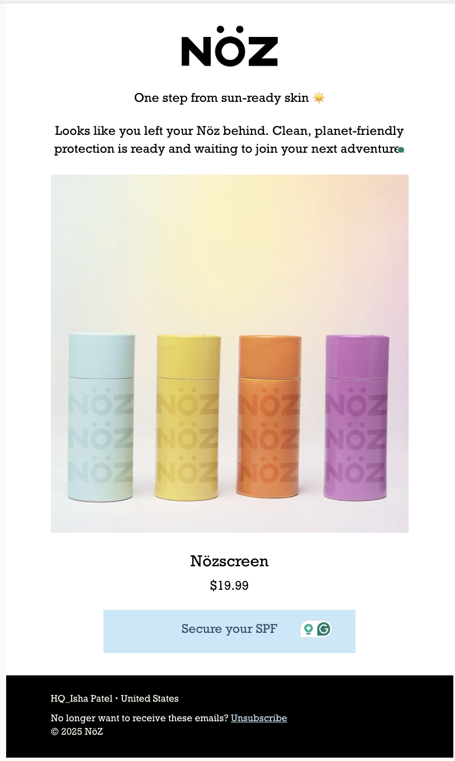
Abandoned Checkout Email (Level Up)

Slide 17

Before submitting your milestone, remember to add your Shopify Link HERE.
*Note: delete this slide after you’ve added your shopify link.

