Slide 1

PORTFOLIO PROJECT: PART 2
Activating the next generation of
charity: water supporters
charity: water
Isha Patel
November 12, 2025

Slide 2

A new donation program
for college students
charity: water
NOTE: This project does NOT include ai tools!

Slide 3
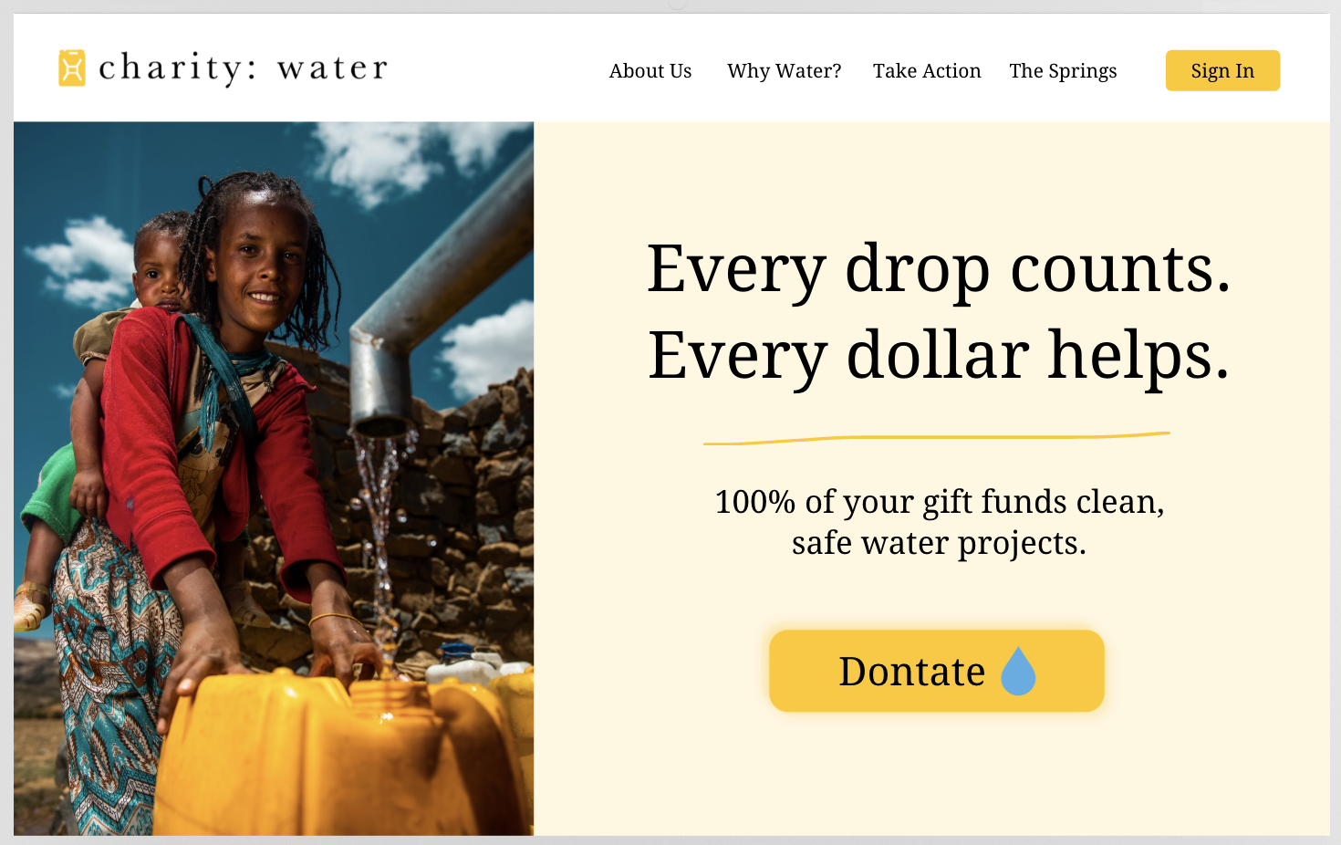
LANDING PAGE
This program appeals to college students because it lets them make a real global impact for only one dollar a month. It is affordable, transparent, and connects them to a community of young people who care about creating change.
charity: water

Slide 4
Organic Social
charity: water

Slide 5
Instagram content pillars targeting
college students
PILLAR 1
Impact Stories
PILLAR 2
Student Action
PILLAR 3
Transparency & Education
charity: water
Instagram Handle: @charitywater

Slide 6
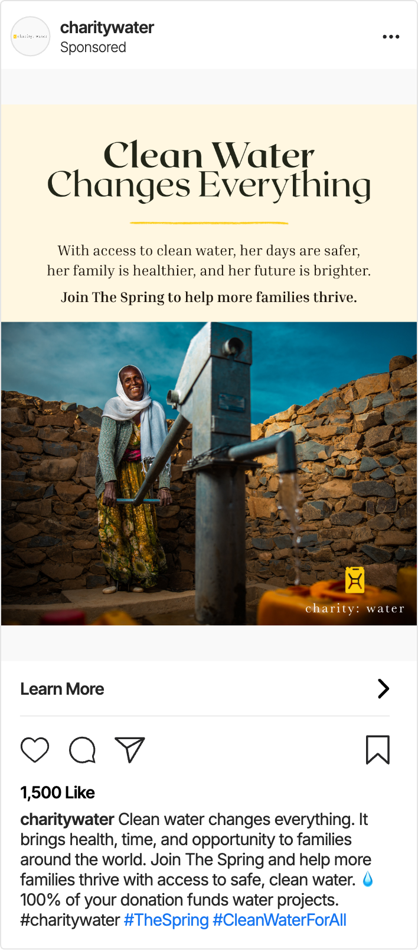
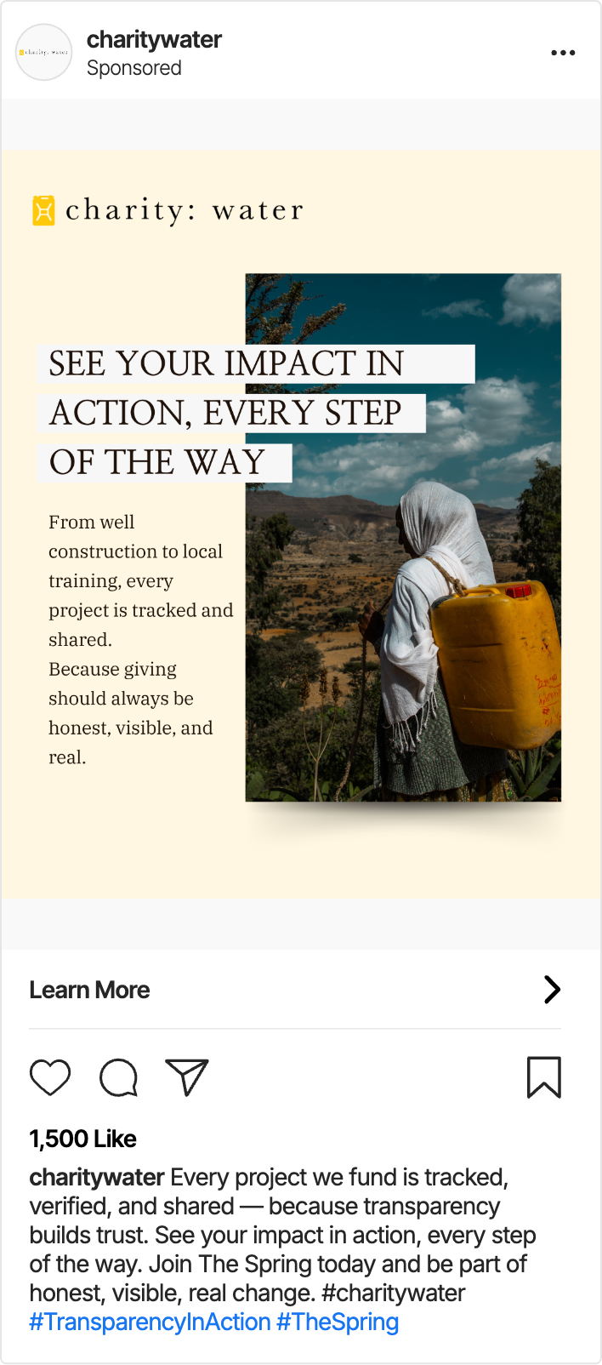
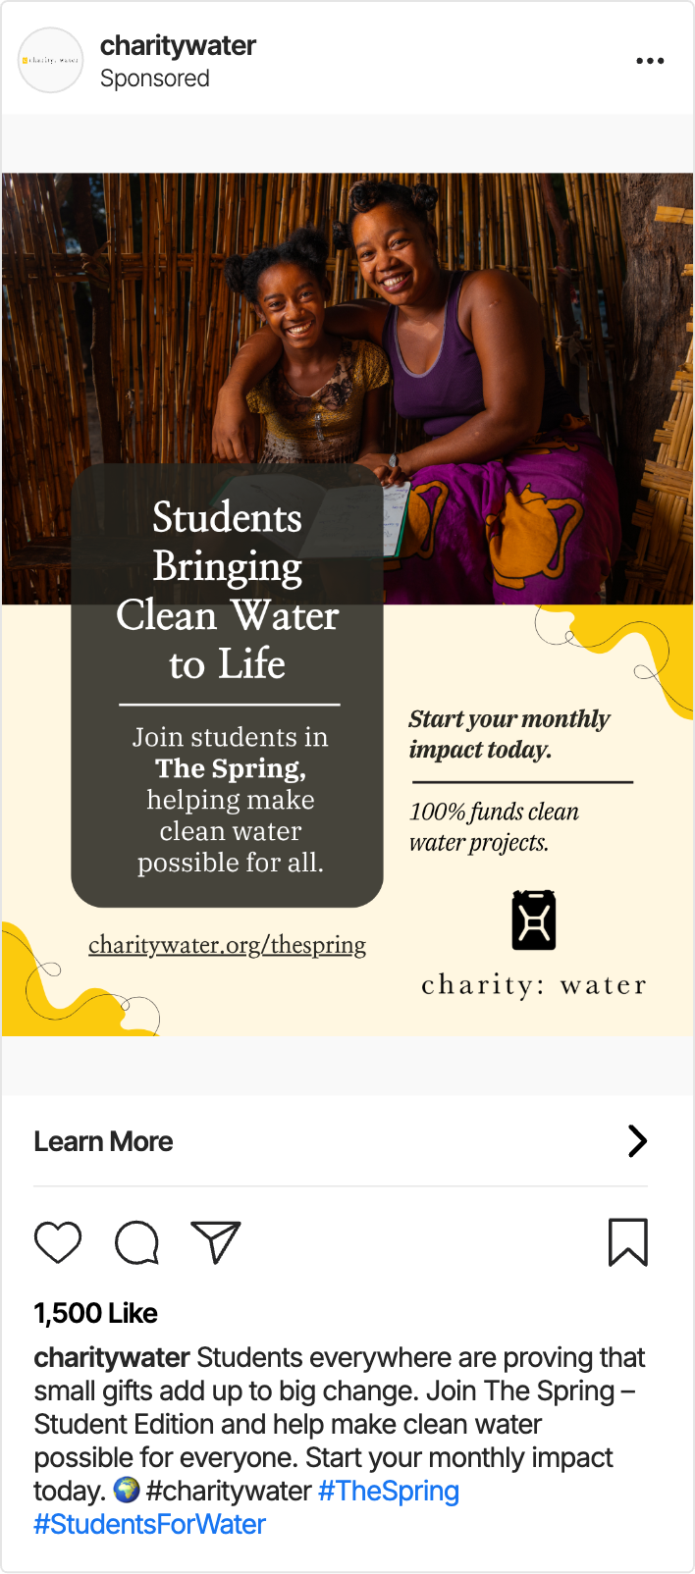
INSTAGRAM POSTS
charity: water
Impact Stories
Student Action
Transparency & Education

Slide 7
Influencer Marketing on Social Media
charity: water

Slide 8
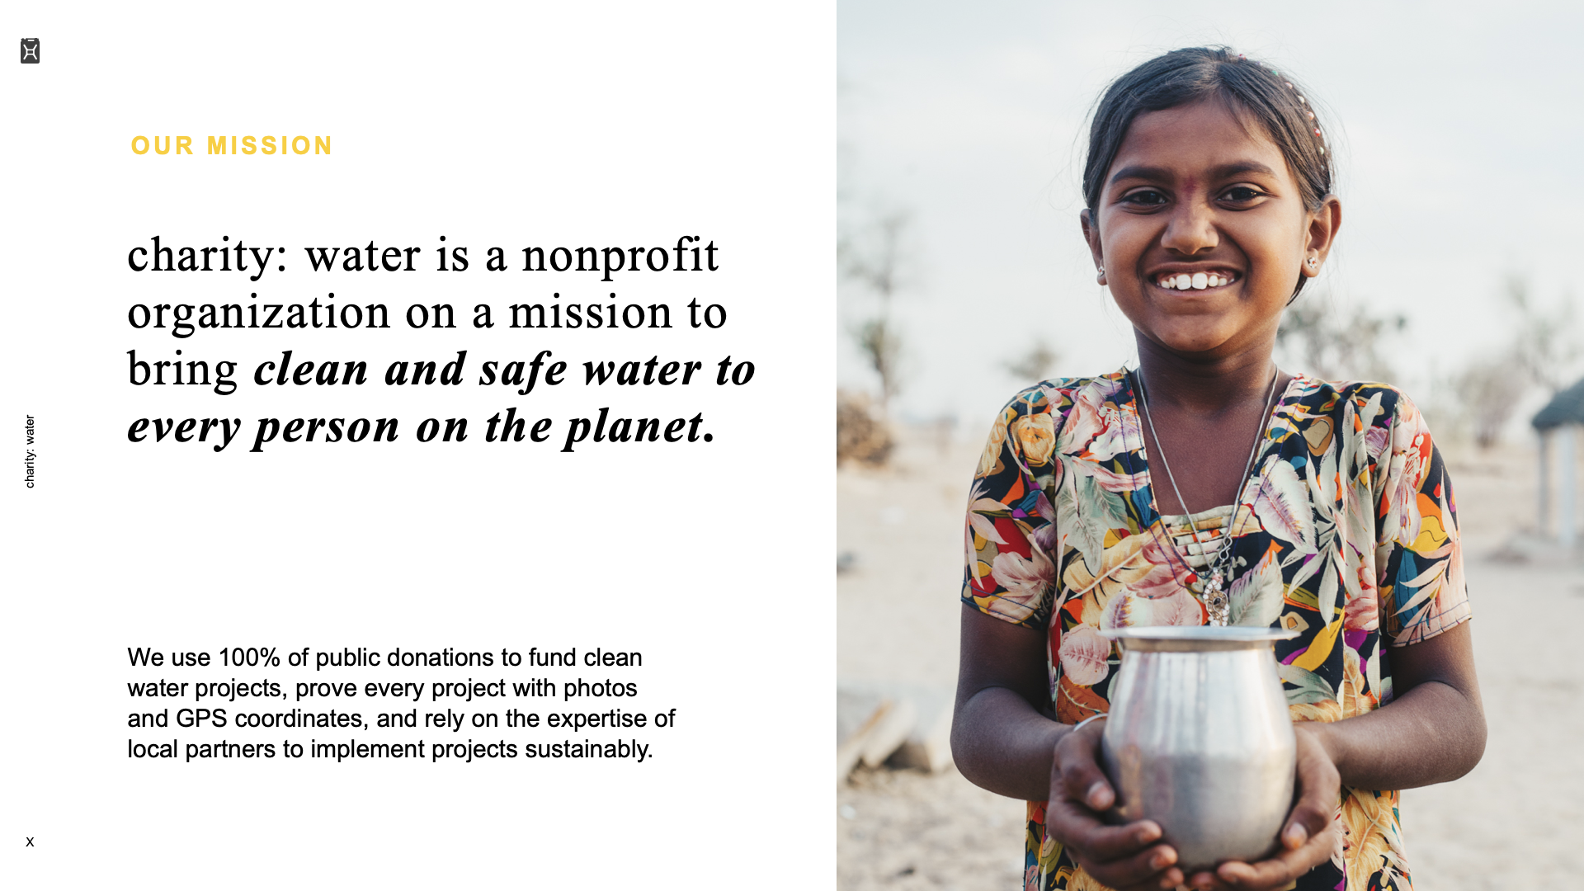
Content must be… Short-form videos (15–30 seconds) for TikTok or Instagram Reels that inspire college students to join The Spring – Student Edition. Each post should highlight how small monthly donations create a big impact on access to clean water.
Content must show… Authentic, uplifting visuals that feature the influencer speaking directly to camera or showing real-life moments of connection, learning, or giving. Include charity: water’s Jerry Can yellow color or logo in a clean, subtle way, and always end with a clear call to action such as “Join The Spring and help fund clean water projects.”
Influencer must be located in…The United States, preferably active within college or university communities where they can reach Gen Z students aged 18–24.
Tone should be…Hopeful, genuine, and empowering. The content should feel authentic and community-focused, encouraging viewers to believe that even small, consistent actions—like giving $1 a month—can create lasting change.
INFLUENCER CONTENT GUIDELINES

Slide 9

INFLUENCER SELECTION CRITERIA
Authentic and Purpose-Driven
Engaged College or Gen Z Audience
Storytelling and Impact Focused

Slide 10
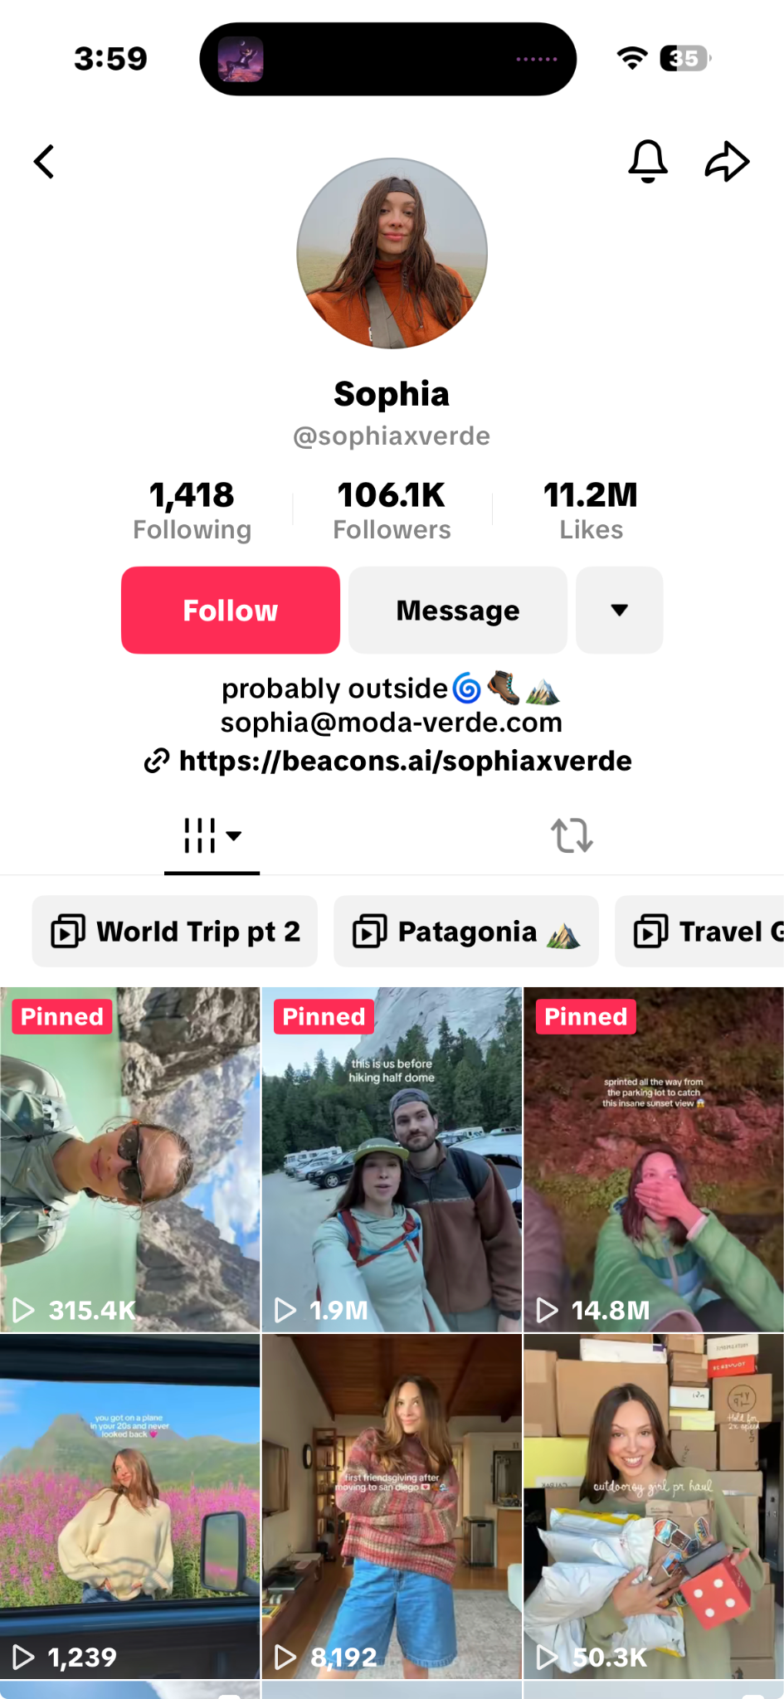
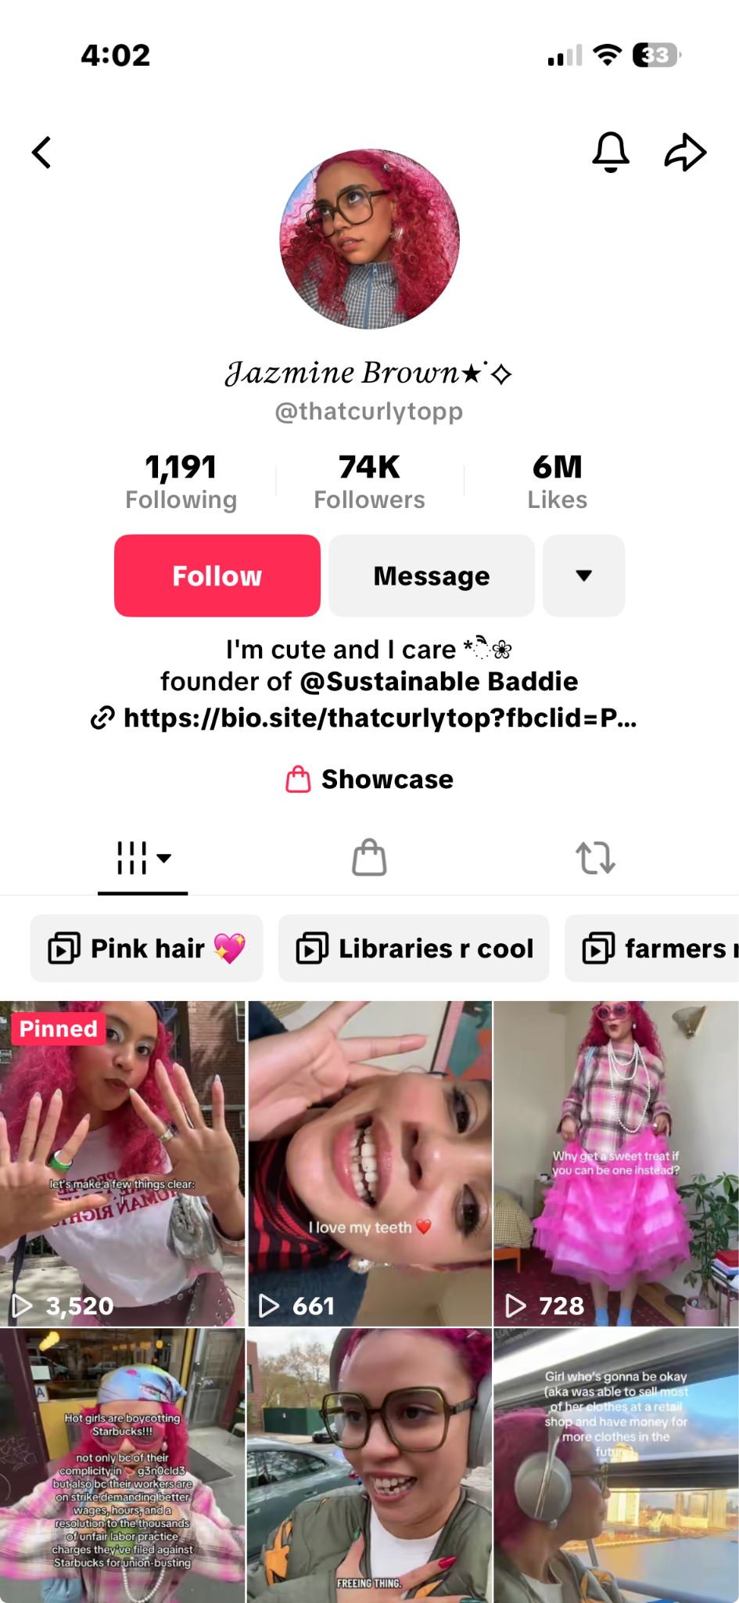
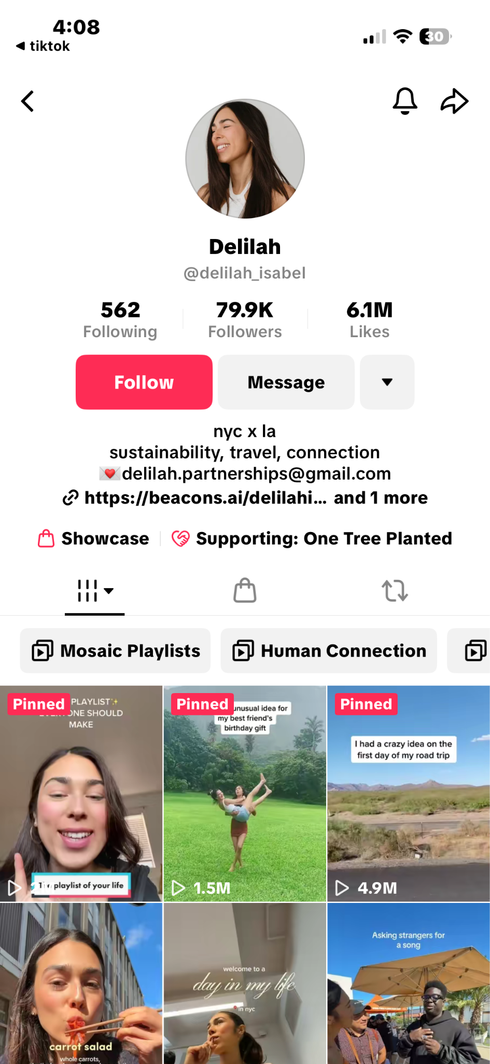
INFLUENCER SELECTION
charity: water
@sophiaxverde
@thatcurlytopp
@delilah_isabel

Slide 11
Paid Social
charity: water

Slide 12
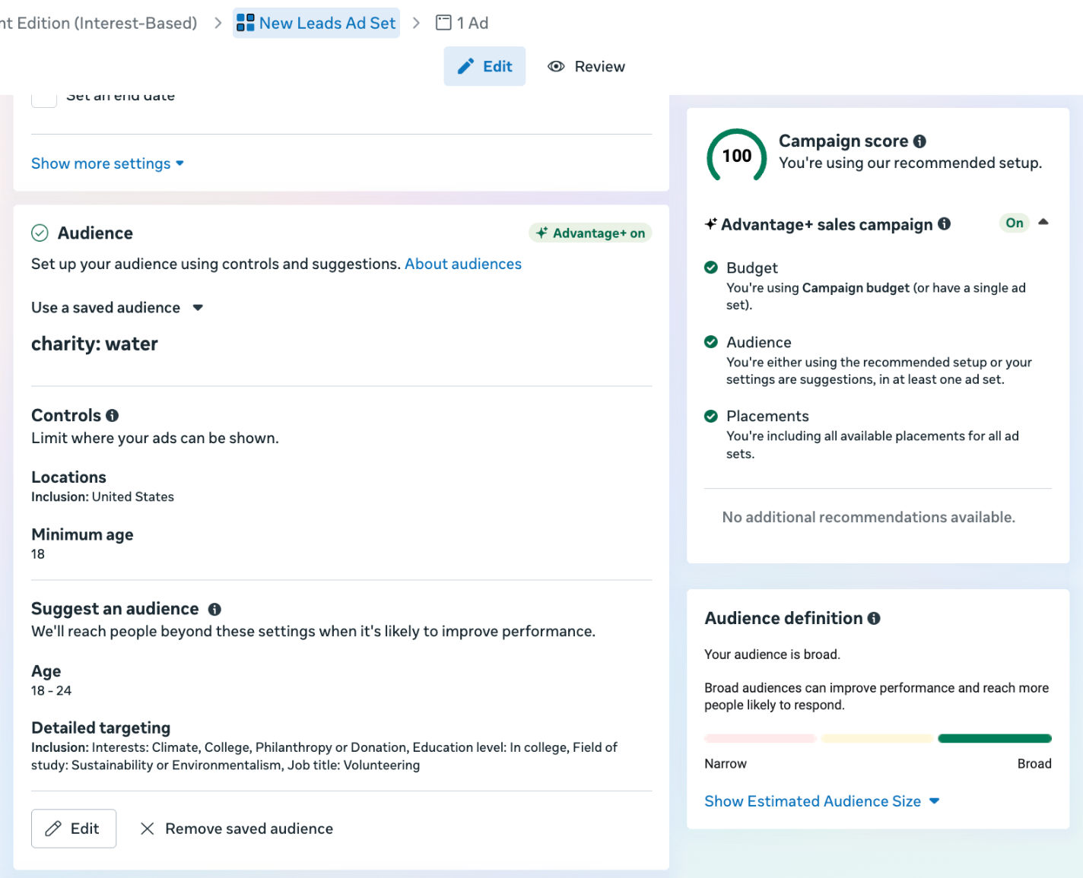
INTEREST-BASED AUDIENCE
Objective: To increase awareness and drive student sign-ups for The Spring – Student Edition through Instagram ads that reach college students interested in sustainability, social causes, and community impact.
KPI: Number of new Spring memberships started by students (goal: 2,000 new donors at $1 per month).
Cost-efficiency metric: Cost per sign-up (CPS), with a target of staying below $12 per new student member to maximize the $25,000 ad budget.
charity: water

Slide 13
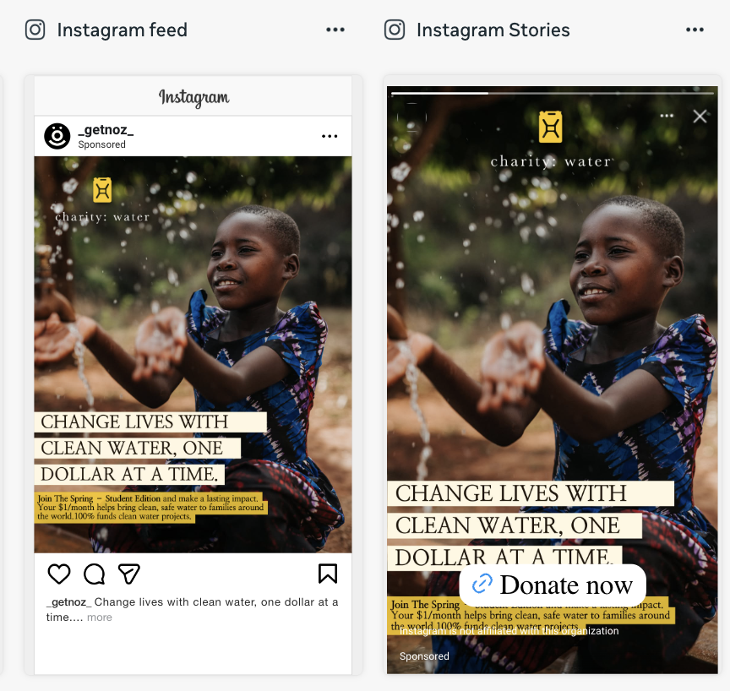
INTEREST-BASED
AD CREATIVE
Using details in the campaign brief, design and program ad creative and copy for your interest-based audience. Add your screenshot to this slide.
charity: water

Slide 14
RETARGETING STRATEGY
The recommended retargeting audience is college students aged 18–24 who have visited charitywater.org/thespring or engaged with charity: water content on Instagram but have not yet signed up.
This group has already shown interest in the cause, so retargeting them with reminder ads and clear calls to action can help convert that interest into action by encouraging them to join The Spring – Student Edition and start giving $1 a month to fund clean water projects.
charity: water

Slide 15
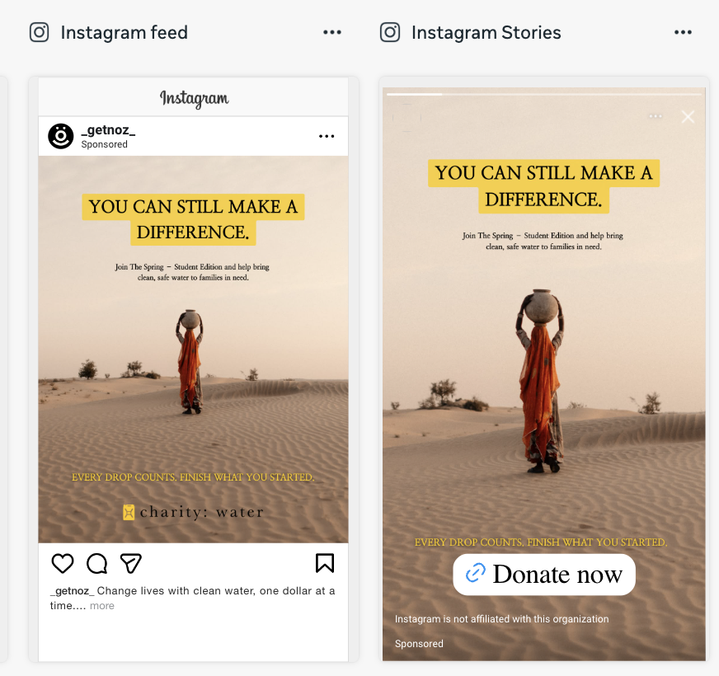
RETARGETING
AD CREATIVE
Using details in the campaign brief, design and program ad creative and copy for your retargeting audience. Add your screenshot to this slide.
charity: water

Slide 16
LevelUp:
Ambassador Program
charity: water

Slide 17
LEVELUP | BRAND EXAMPLE
Brand that’s doing a great job marketing to students on-campus: Redbull
What they do well: Red Bull excels at connecting with college students through experiential marketing, sponsoring campus events, and promoting an energetic lifestyle that aligns with student culture. Their on-campus presence feels authentic and engaging, making the brand part of student life rather than just an advertiser.
charity: water

Slide 18
LEVELUP | charity: water engagement ideas
Campus Pop-Up Experiences: Set up interactive installations showing the impact of clean water projects, where students can fill Jerry Cans or view short videos of communities helped by The Spring.
Student Ambassador Program: Recruit passionate students to represent charity: water on campus, host info tables, and lead small fundraising events.
Clean Water Campus Day: Partner with student organizations to host a day of awareness and fun — including games, giveaways, and storytelling sessions that connect students directly to The Spring – Student Edition.
charity: water

